Slide 2
Investors per angel group is up

Slide 3
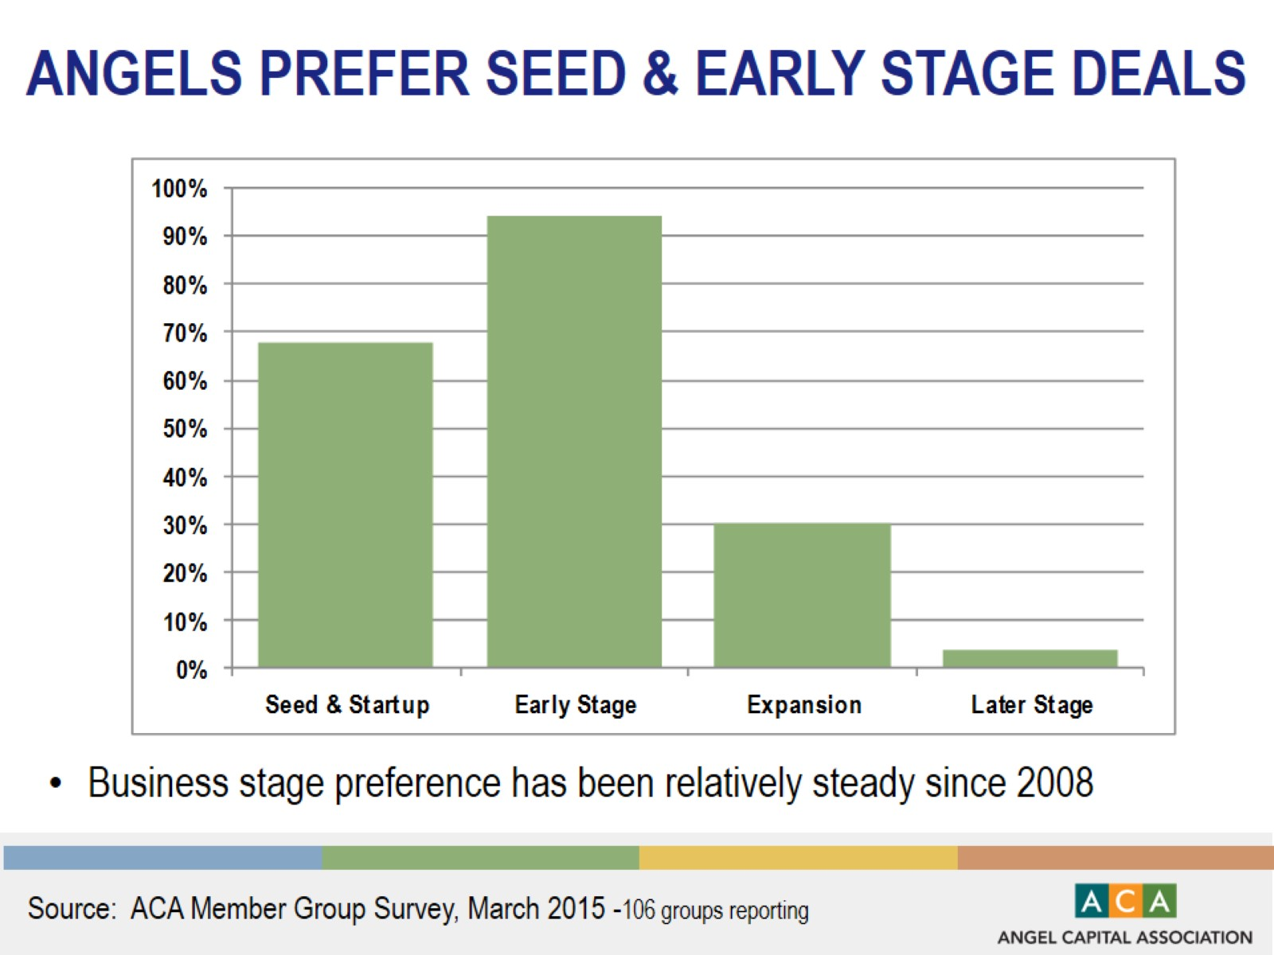
Angels prefer seed & early stage deals

Slide 4
Groups vary in deal activity

Slide 5
Groups vary by amount invested

Slide 6
Portfolio companies create jobs

Slide 7
Exit activity is heating up

Slide 8
Big evolution: where groups invest

Slide 9
Diversity is increasing…we must do more!

Slide 10
Groups interested in many industries

Slide 11
Aca groups by investment structure

Slide 12
ANGEL FUNDS BY DOLLAR SIZE

Slide 13
2015 ANGEL GROUP MEMBER DUES

Slide 14
OPTIMISM FOR INVESTING IN 2015

Slide 15
2015 DEAL SYNDICATION PROSPECTS

